Slide 1
Grandsire Doubles Explained
Learning the Ropes – Level 4/5

Slide 2
New concepts
A dodge
Circle of work
Passing the treble
Blue line
Place bells
Touches – bobs and singles

Slide 3
A dodge
A dodge is when a bell hunting takes a step of one place backwards and then continues to hunt in the original direction.
This bell is hunting up, it takes a step of one place back down before continuing to hunt up.
This bell is hunting down, it takes a step of one place back up before continuing in to hunt down.

Slide 4
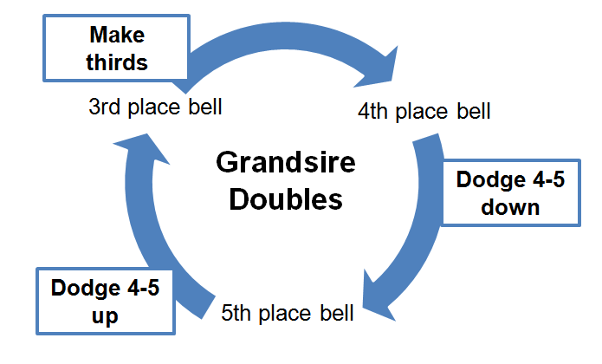
Circle of work
There are three working bells in a plain course of Grandsire Doubles. The treble and the second plain hunt.

Slide 5
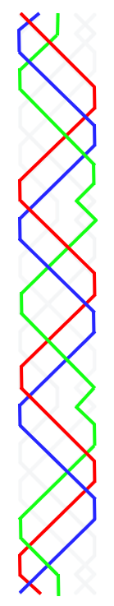



The line for Grandsire Doubles
This a visual representation of Grandsire Doubles
The start for each bell is labelled. These are the place bells
The treble and second plain hunt. They are illustrated in red and blue respectively

Slide 6
Place bells
The number of the place bell refers to the work rung by that bell in the first lead.
In the first lead 3 makes thirds, leads and then hunts to the back.
At the end of the lead it is in fourth place. It is now fourth place bell and rings the work which the 4 rings in the first lead.
In Grandsire Doubles one inside bell does not ring the work but plain hunts. In the plain course this is the 2.

Slide 7
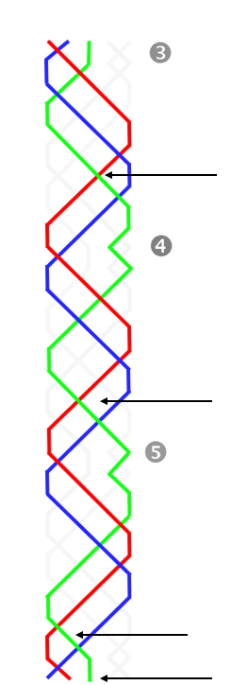
Passing the treble
The work of the 3 (place bells are marked)
Pass the treble in 3-4
Dodge 4-5 down
Pass the treble in 2-3
Dodge 4-5 up
Treble takes your bell off the lead
Make thirds

Slide 8
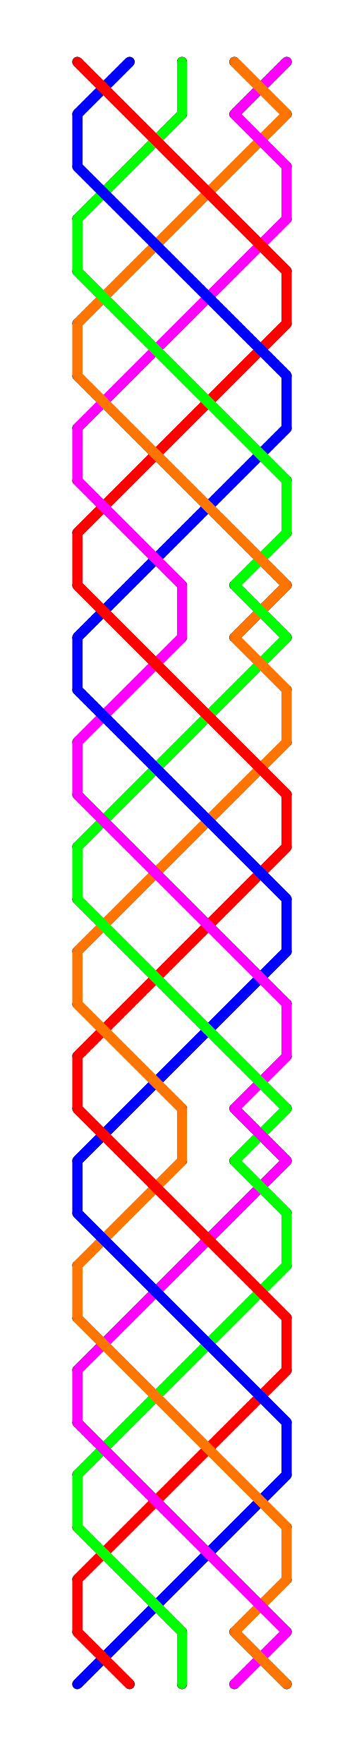
How does Grandsire Doubles work?
All the bells plain hunt until the treble leads
At the lead end, one bell makes thirds which causes the bells in 4-5 to dodge

Slide 9
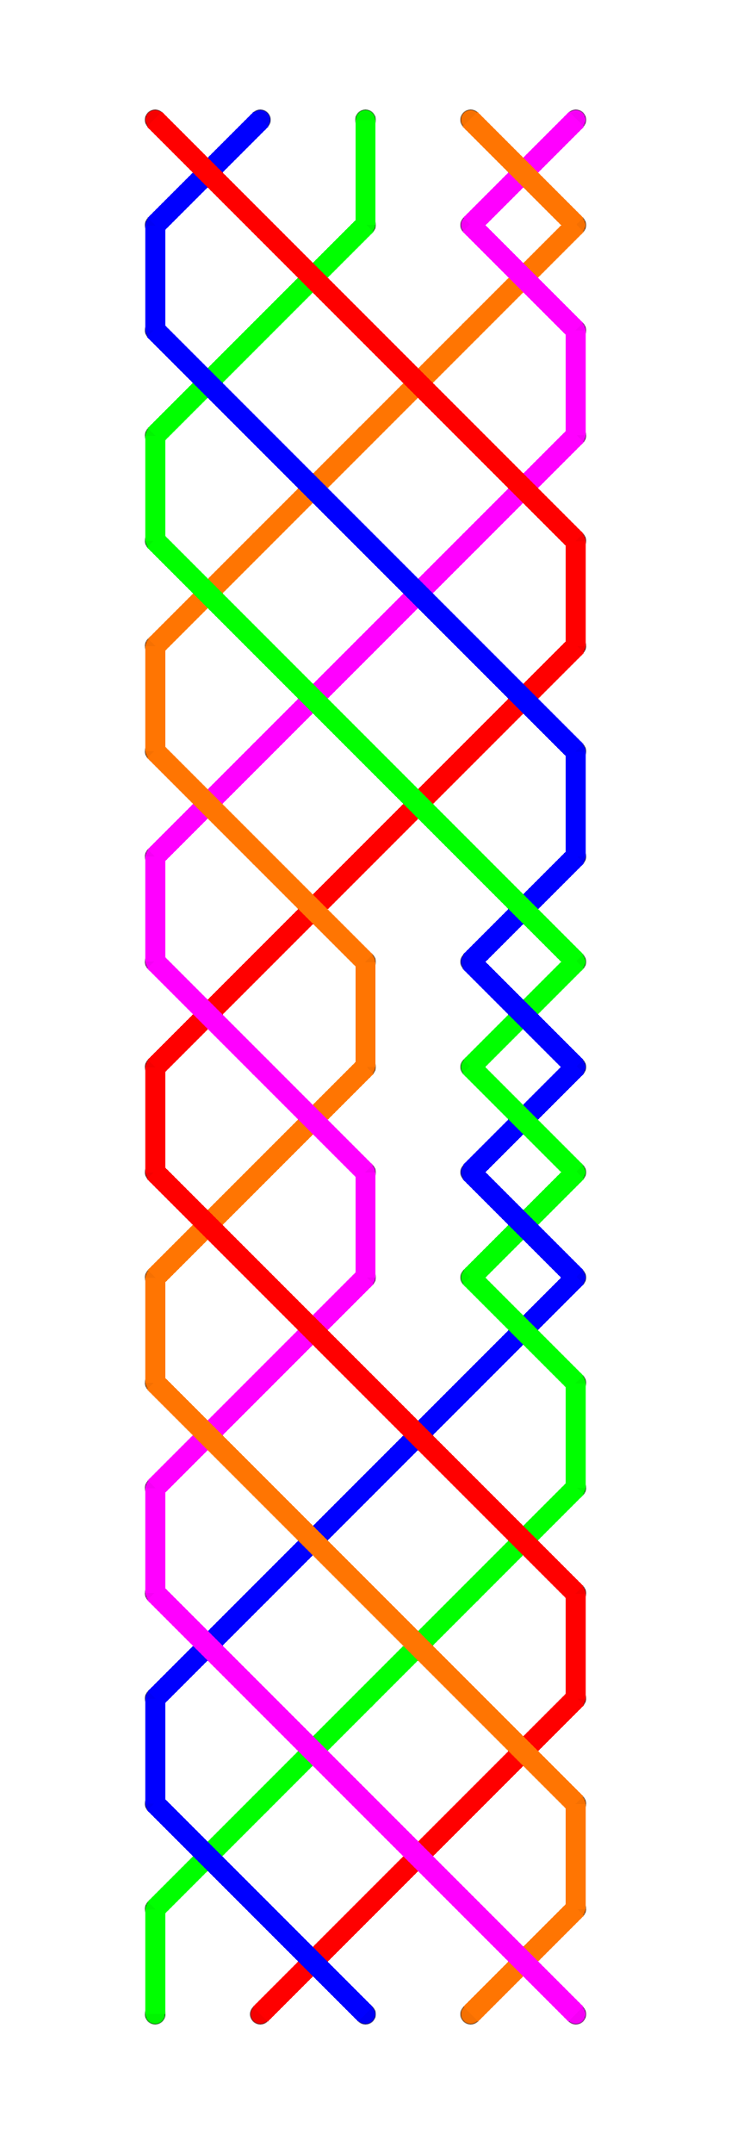
Touches – bobs
When a bob is called…
The bell which was going to dodge 4-5 up rings two blows in third place (early thirds) and goes into the hunt
The bell which was going to dodge 4-5 down double dodges 4-5 up
The bell which was in the hunt double dodges 4-5 down
The bell making thirds is unaffected
bob

Slide 10
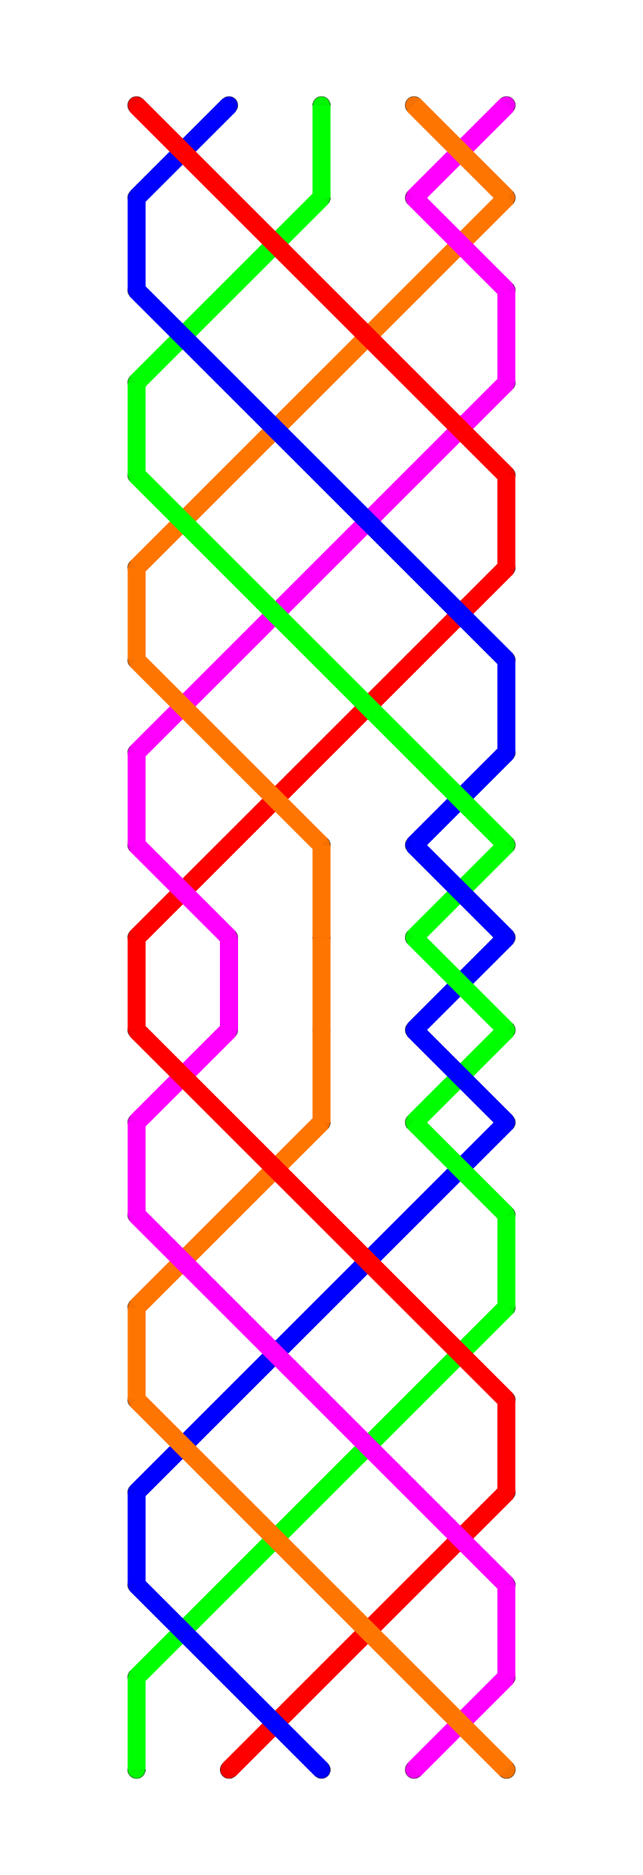
Touches – singles
When a single is called…
The bell which was going to make thirds makes seconds and goes into the hunt
The bell which was going to dodge 4-5 up rings four blows in third place (long thirds)
The bell which was going to dodge 4-5 down double dodges 4-5 up
The bell which was in the hunt double dodges 4-5 down
single

Slide 11
The half hunt bell
In a touch of Grandsire, one bell (the 3 or the 5) does repetitive work, where it alternately makes thirds and double dodges 4-5 up. This is known as doing the half hunt work.
A simple way to call a touch of 60 changes is to do the half hunt work, calling a bob each time your bell is ringing in fourth place over the treble.

Slide 12
Go Grandsire Doubles!

