Slide 1
Plain Bob Doubles Toolbox
Learning the Ropes – Level 4
Theory

Slide 2
New concepts
A dodge
Circle of work
Blue line
Place bells
Passing the treble
Touches

Slide 3
A dodge
A dodge is when a bell hunting takes a step of one place backwards and then continues to hunt in the original direction.
This bell is hunting up, it takes a step of one place back down before continuing to hunt up.
This bell is hunting down, it takes a step of one place back up before continuing to hunt down.

Slide 4
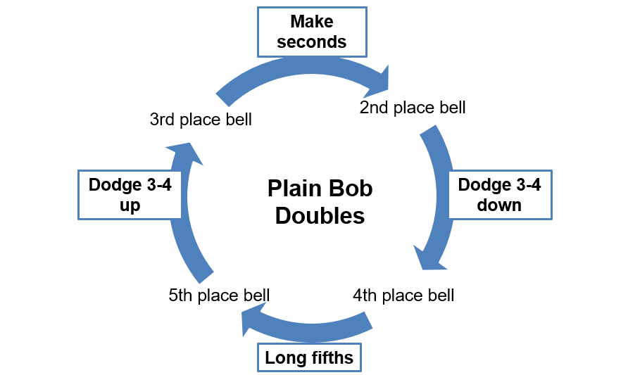
Circle of work
The circle of work is the same for every bell. Each bell starts in its own place, rings one lead and then starts the work of the following place bell until each bell has rung all the work.

Slide 5
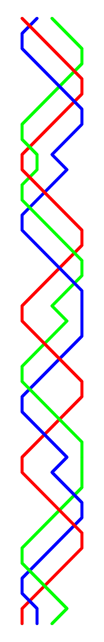




The line for Plain Bob Doubles
This a visual representation of Plain Bob Doubles
A line is drawn to show the path of a bell
The start for each bell is labelled. These are the place bells
The treble plain hunts. It is illustrated in red

Slide 6
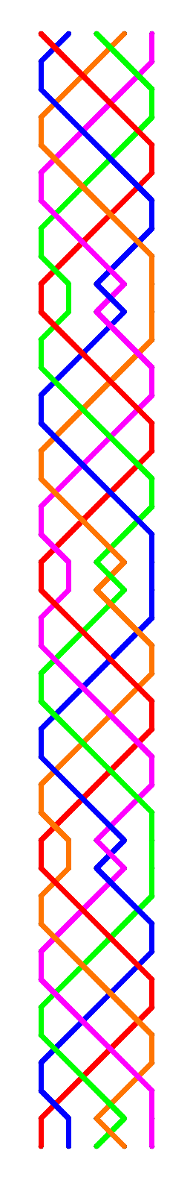
How does Plain Bob Doubles work?
All the bells plain hunt until the treble leads
One bell makes seconds
Which causes the bells in 3-4 to dodge and the bell in 5ths place to ring 4 blows in 5ths place

Slide 7
Place bells
The number of the place bell refers to the work rung by that bell in the first lead
In the first lead lead the 2 leads, hunts to the back and dodges 3-4 down
At the end of the lead it is in fourths place. It is now fourths place bell and rings the work which the 4 would ring in the first lead
Each bell rings the work of every place bell in a plain course

Slide 8
Passing the treble
The work of the 2 (place bells are marked)
Pass the treble in 4-5 (going up)
Next work – dodge 3-4 down
Pass the treble in 3-4 (going up)
Next work – long fifths
Pass the treble in 2-3 (going up)
Next work – dodge 3-4 up
Treble takes your bell off the lead
Next work – make seconds

Slide 9
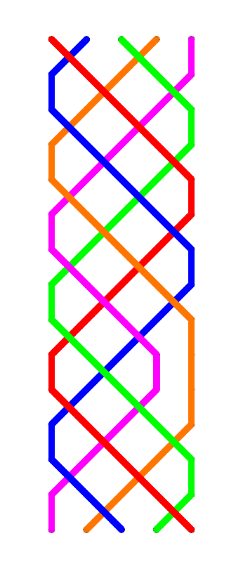
Touches – bobs
When a bob is called…
The bell which was going to dodge 3-4 up rings two blows in 4ths place [makes the bob] and becomes 4ths place bell
The bell which was going to dodge 3-4 down runs in and becomes 2nds place bell
The bell which was going to make seconds runs out and becomes 3rds place bell
The bell ringing 4 blows in 5ths place is unaffected
bob

Slide 10
Go Plain Bob
Doubles!

