Slide 1
Plain Hunt Explained
Learning the Ropes – Level 3

Slide 2
New concepts
Place in the row
Ringing jargon
Ringing at different speeds
Line showing path of a bell
Open handstroke leads
Course and after bells

Slide 3
Place in the row
In rounds all bells strike in their home place.
Places Lead Seconds Thirds Fourths Fifths Sixths 1 2 3 4 5 6
1 2 3 4 5 6

Slide 4
Place in the row
When bells change order they strike in a different place in the row.
Lead Seconds Thirds Fourths Fifths Sixths
1 2 3 4 5 6 2 1 4 3 5 6 The treble is ringing in seconds place. The 4 is in thirds place etc.

Slide 5
Ringing jargon
1 2 3 4 5 6 2 1 4 3 5 6 2 4 1 5 3 6 4 2 5 1 3 6 4 5 2 3 1 6 5 4 3 2 1 6 5 3 4 1 2 6 3 5 1 4 2 6 3 1 5 2 4 6 1 3 2 5 4 6 1 2 3 4 5 6
The bell which rings first in the row is in the lead.
It is at the front.
The bell ringing last is at the back.
It lies behind or it covers.

Slide 6
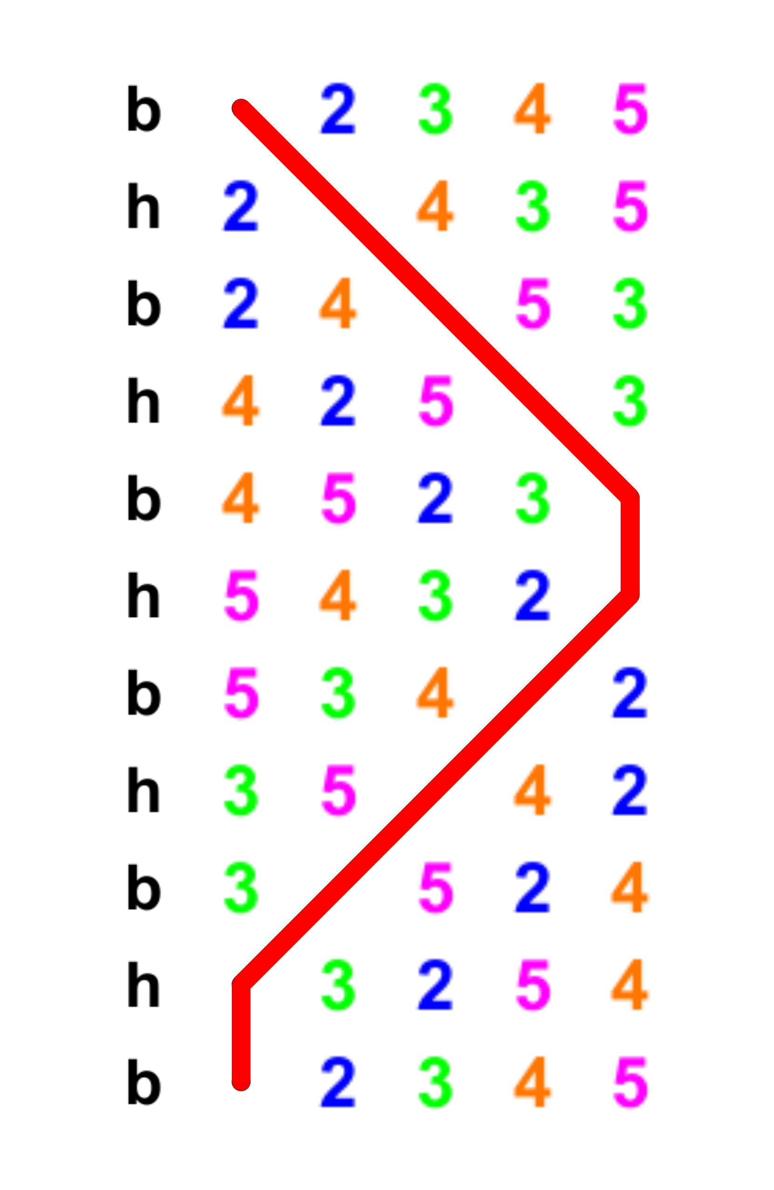
Plain Hunt Doubles
Each bell does the same work but starts at a different place.
A line can be drawn to show the path of a bell.

Slide 7
Ringing the bell at three different speeds
Rounds speed.
Slower than rounds speed.
Quicker than rounds speed.

Slide 8
Ringing at rounds speed
Front
Back
1 2 3 4 5 6 1 2 3 4 5 6
Treble leads
Tenor covers/lies
In rounds a bell has to allow 5 blows to be rung before striking in the home place.
It rings at the same speed in each row.
Notes:
This type of activity can be used as early as during the first handling lessons when taking a break from the rope.
However, the teacher may need to return to it many times in the future until the learner is really familiar with the terms and the concepts.

Slide 9
Ringing slower
1 2 3 4 5 6 1 2 4 3 5 6
Front
Back
Treble leads
Tenor covers/lies
Slow – up – hunts out
When a bell moves up a place it has to ring more slowly, allowing 6 blows to be rung before striking in the new place.
Notes:
This type of activity can be used as early as during the first handling lessons when taking a break from the rope.
However, the teacher may need to return to it many times in the future until the learner is really familiar with the terms and the concepts.

Slide 10
Ringing quicker
1 2 3 4 5 6 1 2 4 3 5 6
Front
Back
Treble leads
Tenor covers/lies
Quick – down – hunts in
When a bell moves down a place it has to ring more quickly, allowing 4 blows to be rung before striking in the new place.
Notes:
This type of activity can be used as early as during the first handling lessons when taking a break from the rope.
However, the teacher may need to return to it many times in the future until the learner is really familiar with the terms and the concepts.

Slide 11
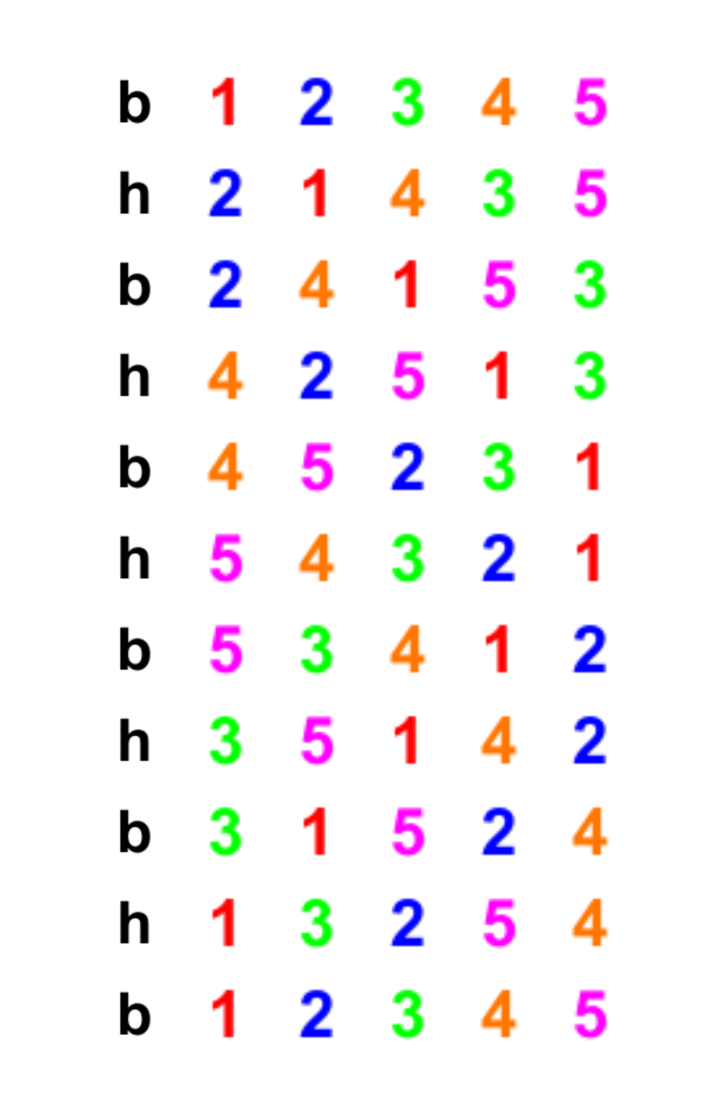
Hunting up to the back
The bells going out to the back all have to ring more slowly.
Ringing slower jargon:
Hunt up
Run out
Slow
Up to the back

Slide 12
Hunting down to the lead/front
The bells going down to the front all have to ring more quickly.
Ringing quicker jargon:
Hunt down
Run in
Down
Down to the front

Slide 13
Leading and lying
When a bell leads at handstroke it must leave an extra space equivalent to one bell striking. This is the open handstroke lead.
When leading and lying you have to ring at rounds speed.

Slide 14
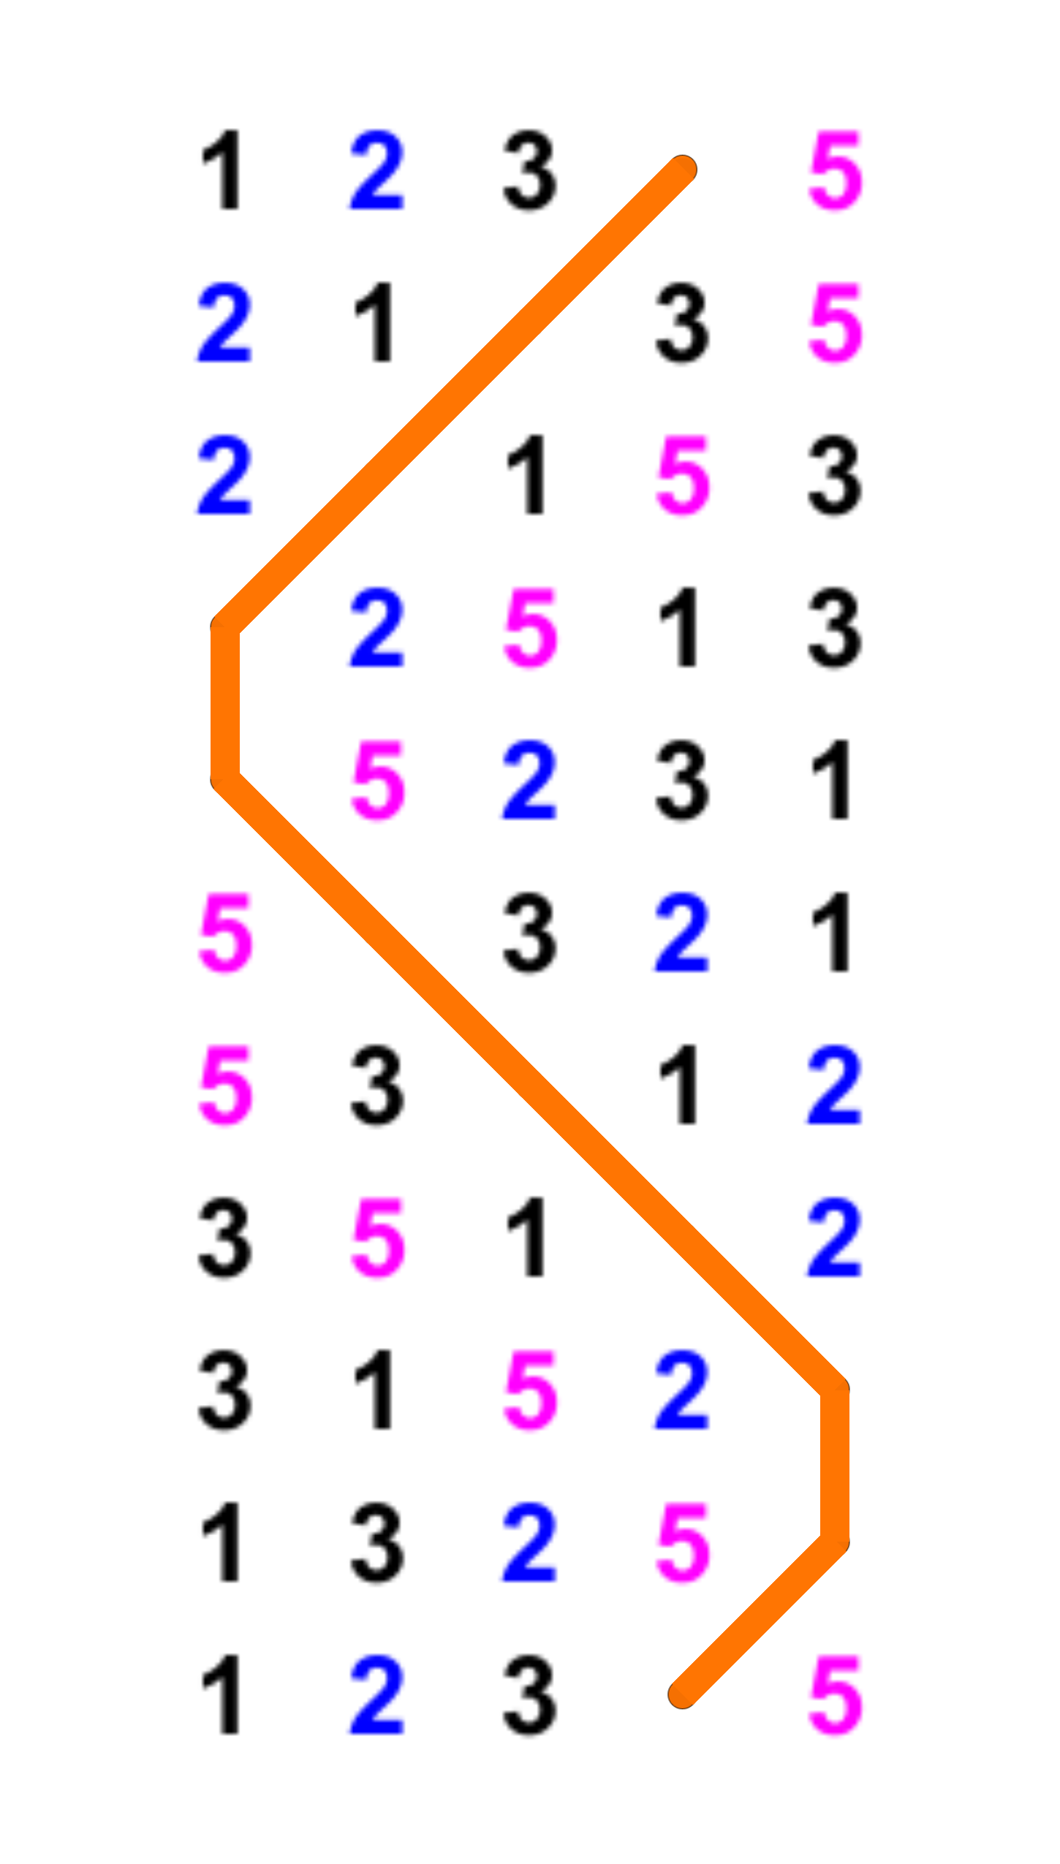
Course and after bells
Your course bell is the bell you ring over before you lead.
You take it off the lead.
Your after bell is the bell you ring over in seconds place after leading.
It takes you off the lead.

Slide 15
Happy Hunting!

